Slide 1

Wellcome To Ethical Hacking class 3rd Week Day 2nd
Muhammad Bilal

Slide 2
Operating System Detection
Definition:
Operating System (OS) detection is the process of identifying the operating system running on a remote machine or network device. This is a crucial step in network security assessments, as it helps to identify potential vulnerabilities and tailor attack strategies or defense mechanisms.
Examples:
1. Nmap:
Using Nmap, a network scanning tool, to perform OS detection on a network. For instance, running the command `nmap -O 192.168.1.1` can help identify the operating system of the device at that IP address.
2.Passive OS Fingerprinting:
This involves analyzing network traffic to infer the operating system. For example, using tools like p0f, which capture and analyze network packets without actively sending any probes.

Slide 3
Operating System Detection
Techniques and Tools:
- Nmap:
A widely used network scanner that can detect operating systems using TCP/IP stack fingerprinting.
- p0f:
A passive OS fingerprinting tool that analyzes network traffic to determine the operating system.
- Xprobe2:
An active OS fingerprinting tool that uses ICMP probes to identify operating systems.
- Websites:
Resources such as [Exploit Database](https://www.exploit-db.com/) can provide information on vulnerabilities related to specific operating systems.

Slide 4
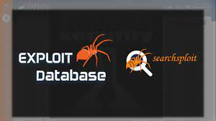


Slide 5
Automated Scanning Workflows
Definition:
Automated scanning workflows involve the use of tools and scripts to automate the process of scanning networks or systems for vulnerabilities. This helps in efficiently identifying potential security risks without manual intervention.
Examples:
1. Continuous Integration (CI) Scans:
Integrating automated security scans into CI pipelines using tools like Jenkins or GitLab CI to ensure code changes are automatically scanned for vulnerabilities.
2. Scheduled Network Scans:
Setting up automated scans with tools like Nessus or OpenVAS to run at regular intervals, ensuring that the network is consistently monitored for vulnerabilities.

Slide 6
Automated Scanning Workflows
Techniques and Tools:
- Nessus:
A vulnerability scanning tool that can be scheduled to run automated scans.
- OpenVAS:
An open-source tool that supports automation for vulnerability scanning.
- Jenkins/GitLab CI:
CI/CD platforms that can be configured to run automated security scans as part of the deployment pipeline.
- Websites:
[OWASP ZAP](https://www.zaproxy.org/) provides resources and tools for automated web application security testing.

Slide 7



Slide 8
Scanning for Web Applications
Definition:
Scanning for web applications involves analyzing web applications to identify security vulnerabilities such as SQL injection, cross-site scripting (XSS), and other common web threats.
Examples:
1. SQL Injection Scan:
Using tools like SQLMap to automatically detect and exploit SQL injection vulnerabilities in web applications.
2. XSS Detection:
Running a scan with tools like OWASP ZAP to identify cross-site scripting vulnerabilities in a web application.

Slide 9
Scanning for Web Applications
Techniques and Tools:
- Burp Suite:
A comprehensive platform for web application security testing that can identify and exploit vulnerabilities.
- OWASP ZAP:
An open-source tool for finding vulnerabilities in web applications.
- Acunetix:
A web vulnerability scanner that can detect a wide range of web application vulnerabilities.
- Websites:
[OWASP](https://owasp.org/) offers extensive resources on web application security testing and best practices.

Slide 10



Slide 11
Threat Intelligence Integration
Definition:
Threat intelligence integration involves incorporating external threat intelligence data into security systems to enhance threat detection and response capabilities. This can include information about known vulnerabilities, attack patterns, and malicious IP addresses.
Examples:
1. SIEM Integration:
Integrating threat intelligence feeds with Security Information and Event Management (SIEM) systems like Splunk to enhance alerting and incident response.
2. Firewall Rules Update:
Using threat intelligence data to automatically update firewall rules to block known malicious IP addresses.

Slide 12
Threat Intelligence Integration
Techniques and Tools:
Threat Intelligence Platforms (TIPs):
A comprehensive platform for web application security testing that can identify and
exploit vulnerabilities.
SIEM Tools:
An open-source tool for finding vulnerabilities in web applications.
Firewalls:
A web vulnerability scanner that can detect a wide range of web application vulnerabilities.
- Websites:
[Threat Intelligence Platform](https://threatintelligenceplatform.com/) offers tools and services for integrating threat intelligence.

Slide 13
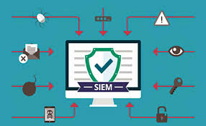
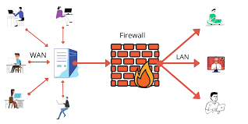

Slide 14
Wireless Network Scanning
Definition:
Wireless network scanning is the process of discovering and analyzing wireless networks to identify security weaknesses, unauthorized access points, and other threats.
Examples:
1. Wi-Fi Security Assessment:
Using tools like Aircrack-ng to capture and analyze Wi-Fi traffic for security vulnerabilities.
2. Rogue Access Point Detection:
Scanning for unauthorized access points using tools like Kismet to ensure network integrity.

Slide 15
Wireless Network Scanning
Techniques and Tools:
Aircrack-ng:
A suite of tools for assessing the security of Wi-Fi networks.
Kismet:
A wireless network detector and intrusion detection system.
Wireshark:
A network protocol analyzer that can capture and analyze wireless traffic.
Websites:
[Wigle](https://wigle.net/) provides a database of wireless networks that can be used for reconnaissance.

Slide 16
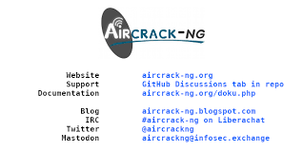


Slide 17
Automating Scans with Scripts
Definition:
Automating scans with scripts involves writing scripts to automate the process of scanning systems or networks for vulnerabilities, thereby saving time and reducing manual effort.
Examples:
1. Bash Script for Nmap:
Writing a Bash script to automate the execution of Nmap scans across multiple IP addresses.
2. Python Script for Vulnerability Scanning:
Using Python to automate the execution of vulnerability scanning tools like OpenVAS or Nessus.

Slide 18
Automating Scans with Scripts
Techniques and Tools:
Bash/Shell Scripting:
Writing scripts to automate command-line tools like Nmap.
- Python:
Using Python libraries such as `subprocess` to automate scanning tools.
- PowerShell:
Automating scans on Windows systems using PowerShell scripts.
Websites:
[GitHub](https://github.com/) hosts numerous repositories with sample scripts for automating security scans.

Slide 19

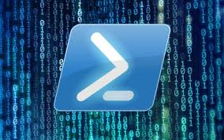

Slide 20
Scanning Best Practices
Definition:
Scanning best practices involve following established guidelines and methodologies to ensure effective and ethical vulnerability scanning, minimizing risks, and maximizing results.
Examples:
1. Regular Scanning Schedule:
Establishing a regular schedule for vulnerability scans to ensure continuous monitoring and timely detection of new vulnerabilities.
2. Comprehensive Scan Coverage:
Ensuring scans cover all critical assets and systems to provide a complete view of the security posture.

Slide 21
Scanning Best Practices
Documentation:
Maintain thorough documentation of scanning processes, findings, and remediation efforts.
- Risk Assessment:
Conduct risk assessments to prioritize scanning efforts based on asset criticality.
- Access Control:
Ensure proper access controls are in place to prevent unauthorized scanning activities.
- Websites:
[CIS Security](https://www.cisecurity.org/) provides guidelines and benchmarks for best practices in security scanning.

Slide 22

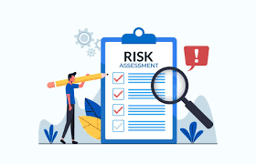

Slide 23
Scanning Ethics and Legal Considerations
Definition:
Scanning ethics and legal considerations refer to the ethical and legal responsibilities involved in conducting vulnerability scans, ensuring compliance with laws and regulations, and respecting the privacy and rights of others.
Examples:
1. Obtaining Consent:
Always obtain explicit permission from system owners before conducting any scans to avoid legal repercussions.
2. Avoiding Unauthorized Scans:
Ensure that scanning activities are authorized and do not infringe on the privacy or rights of individuals or organizations.

Slide 24
Scanning Ethics and Legal Considerations
Techniques and Tools:
- Legal Guidance:
Consult legal experts to ensure compliance with relevant laws and regulations.
- Ethical Guidelines:
Follow ethical guidelines provided by organizations such as (ISC)² or ISACA.
- Websites:
[ISACA](https://www.isaca.org/) offers resources on ethical and legal considerations in cybersecurity.

Slide 25
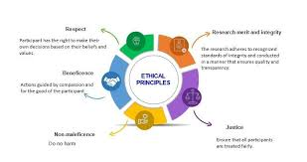


Slide 26
Post-Scanning Analysis
Definition:
Post-scanning analysis involves reviewing and interpreting the results of vulnerability scans to prioritize remediation efforts and improve the overall security posture.
Examples:
1. Vulnerability Prioritization:
Analyzing scan results to prioritize vulnerabilities based on severity and potential impact, focusing on critical issues first.
2. Remediation Planning:
Developing a plan to address identified vulnerabilities, including patching, configuration changes, and other mitigation strategies.

Slide 27
Post-Scanning Analysis
Techniques and Tools:
Reporting Tools:
Use tools like Nessus or Qualys to generate detailed reports and analysis of scan results.
Threat Modeling:
Incorporate threat modeling techniques to assess the potential impact of identified vulnerabilities.
Websites:
[Rapid7](https://www.rapid7.com/) provides resources and tools for post-scanning analysis and remediation.

Slide 28

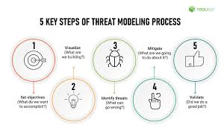

Slide 29
Scanning for Insider Threats
Definition:
Scanning for insider threats involves monitoring internal network activities to detect malicious or negligent actions by employees or other insiders that could harm the organization.
Examples:
1. User Behavior Analytics (UBA):
Using UBA tools to detect anomalous user activities that may indicate insider threats, such as unauthorized data access or exfiltration.
2. Access Monitoring:
Regularly reviewing and updating user permissions to ensure compliance with the least privilege principle.

Slide 30
Scanning for Insider Threats
Techniques and Tools:
Splunk User Behavior Analytics::
Splunk UBA is a tool that leverages machine learning to analyze user behavior and detect insider threats. It identifies anomalies and generates risk scores to prioritize investigations.
Varonis:
Varonis is a data security platform that helps protect sensitive information by monitoring and analyzing data access patterns. It provides insights into potential insider threats and helps enforce access controls.
Websites:
[Splunk](https://www.splunk.com/) Splunk is a software platform used for monitoring, searching, and analyzing machine-generated data.

Slide 31

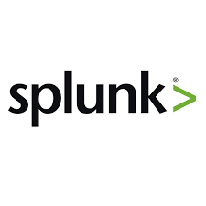

Slide 32
Happy Hacking

